Slide 1
SW side update

Slide 2
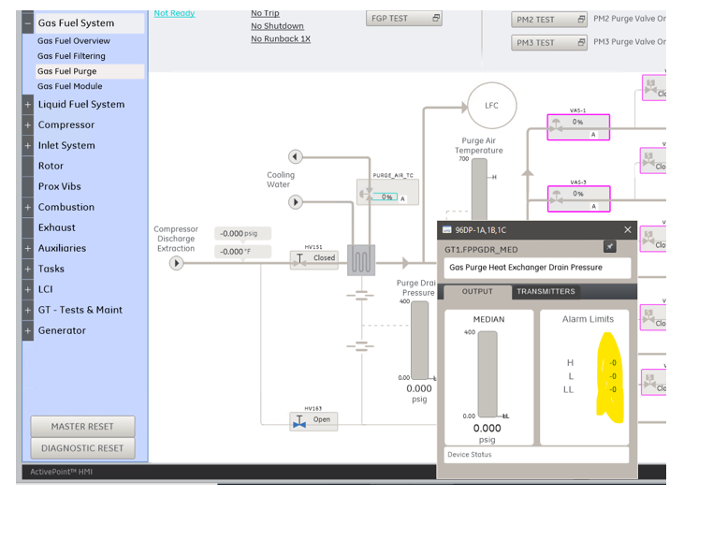
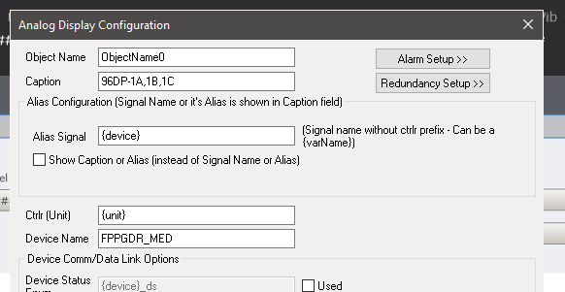
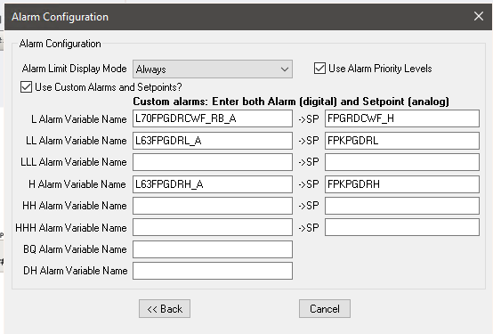

Slide 3
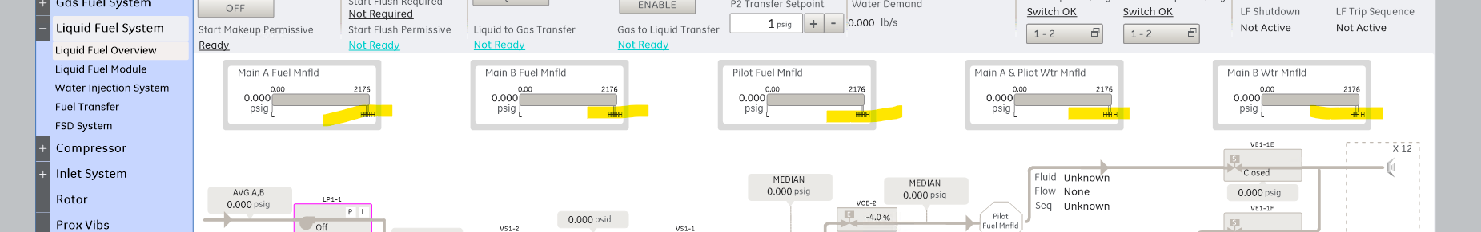
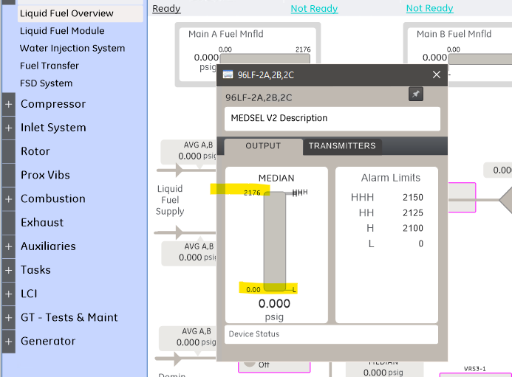
LF_MAINA_MNFLD_P_MED LF_MAINB_MNFLD_P_MED LF_PILOT_MNFLD_P_MED LF_MAINA_WTR_MNFLD_P_MED LF_MAINB_WTR_MNFLD_P_MED update the display limits of this and those set points

Slide 4
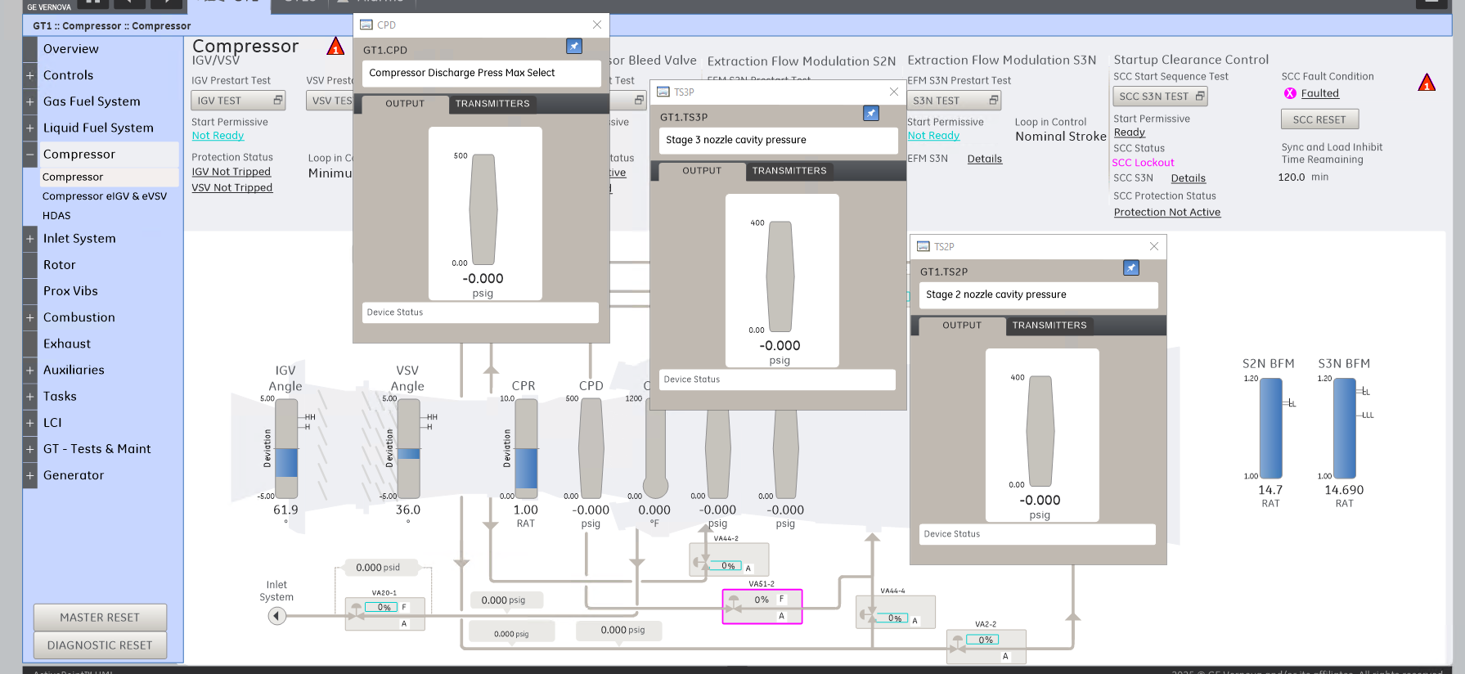
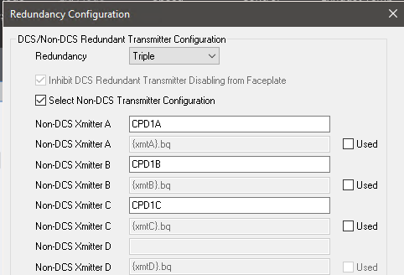
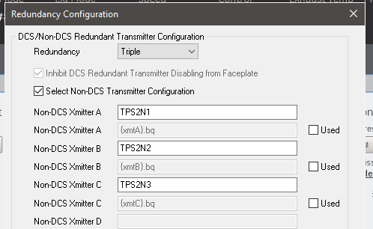
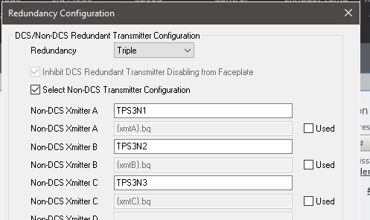
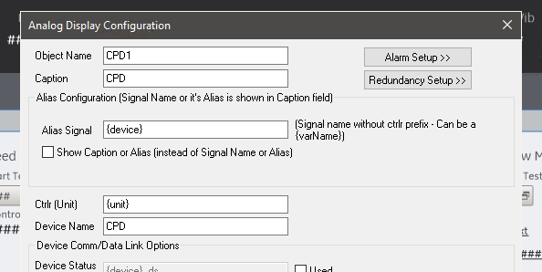
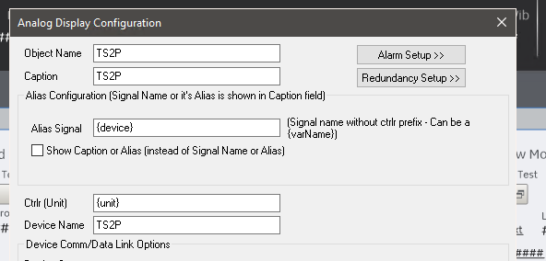
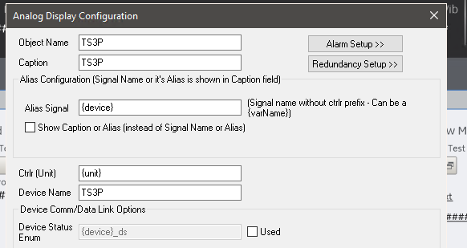

Slide 5
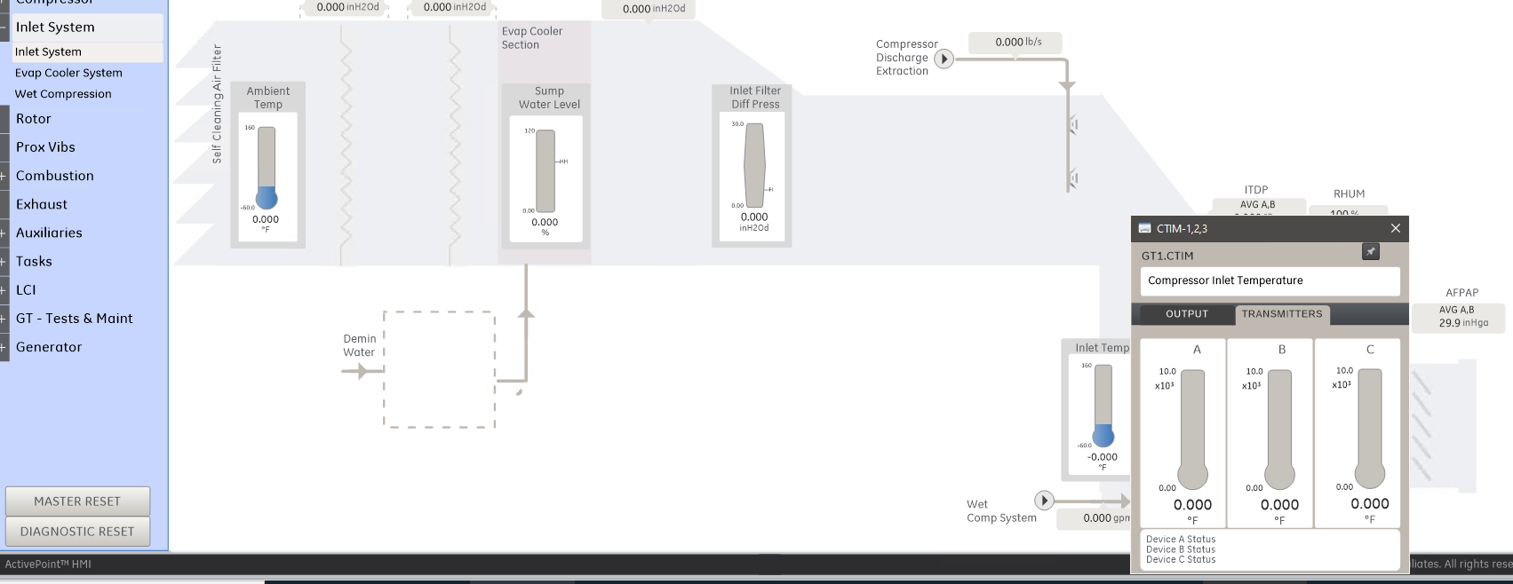
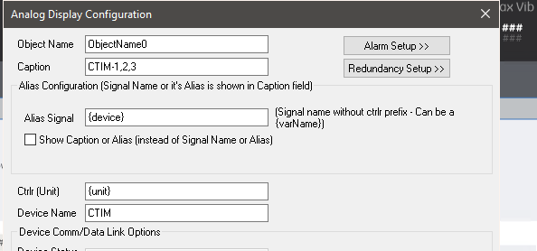
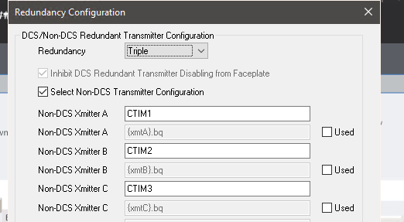

Slide 6
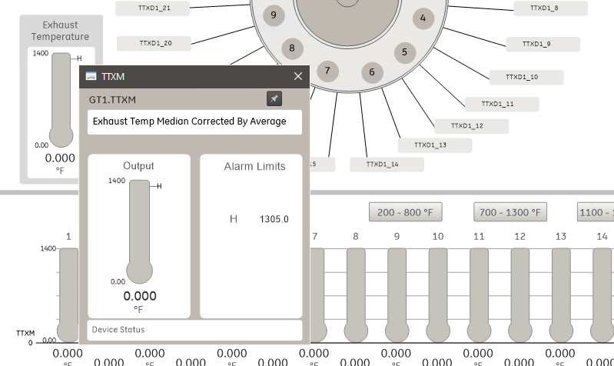
KTX_OT2H
NEED FORMATE SPEC FOR THIS SETPOINT

Slide 7
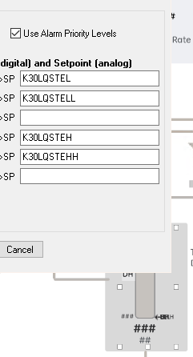
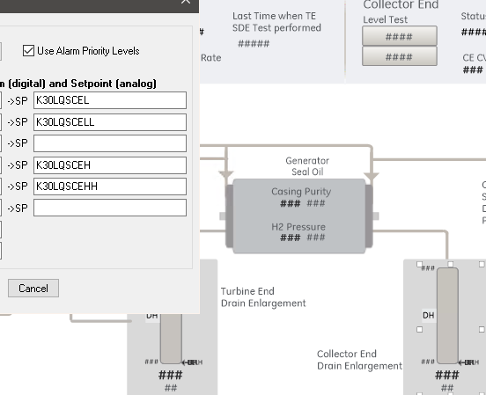
Update format spec
Update description of this variables
OFWWON_PMT OFWWOFF_FRC ONWWON_PMT ONWWOFF_FRC
Refer Verbena
Format spec to S_LenLvl_in_0_10_2
Format spec to S_LenLvl_in_0_10_2

Slide 8
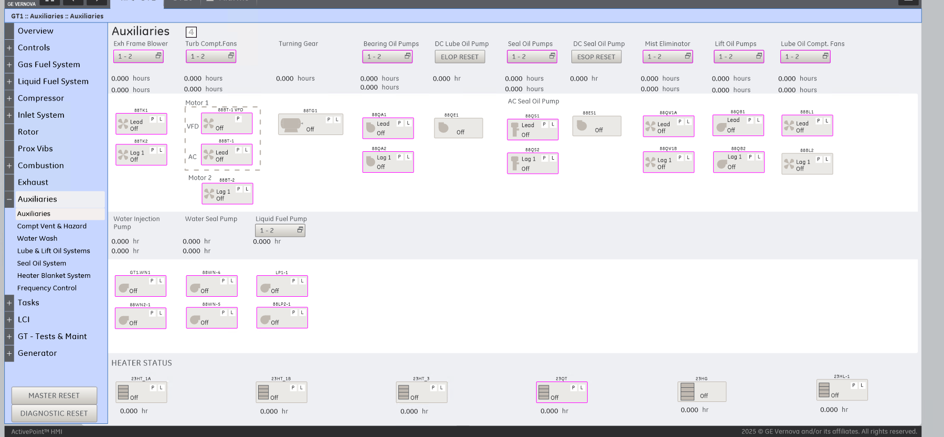
Need to check again all Profibus related, because attribute change

Slide 9
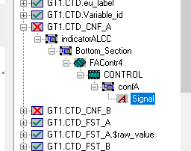
CTD_CNF_A CTD_CNF_B
In Library the task instance script is false ?
we need this MBC Screen

Slide 10
Add in EGD
L20WV_TRP_AC
96FG-2A,2B,2C 96FG25A,25B,25C
why 96FG-1A,1B is duel FIO is also like same, so I deleted the 96FG-1C object in screen

